Slide 1
Integration of Third-Party Smart Locks into the Smart Home System
Aleksandar Zagorac and Marija Antic

Slide 2
MULTIPLE SMART HOME COMPANIES

Slide 3
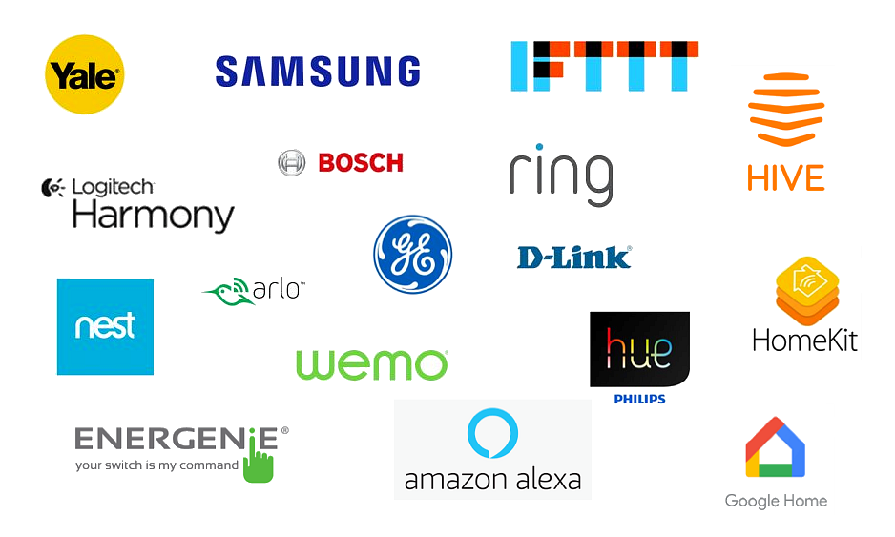

Slide 4

SOLUTIONS FOR SOME PARTS OF THE SMART HOME SYSTEM

Slide 5

COLLABORATION

Slide 6

AND …

Slide 7





SMART HOME CLOUD
THIRD PARTY CLOUD
MOBILE APP
GATEWAY
GATEWAY
SMART DEVICES
SMART LOCK

Slide 8
EXISTING SMART HOME CLOUD
THIRD PARTY CLOUD
ADAPTER SERVICE
HTTPS
EXPOSED API

